Slide 1

G9
MOBILE
PROGRAMING
DR. VALERY

Slide 2

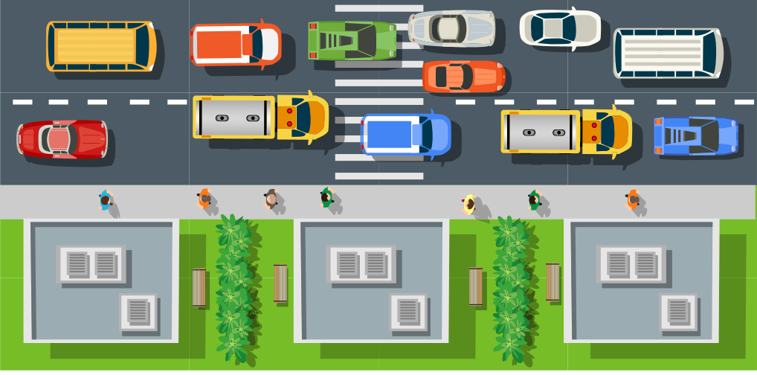
&
DISIGN
IMPLEMENTATION
OF
TRIPTRACK

Slide 3
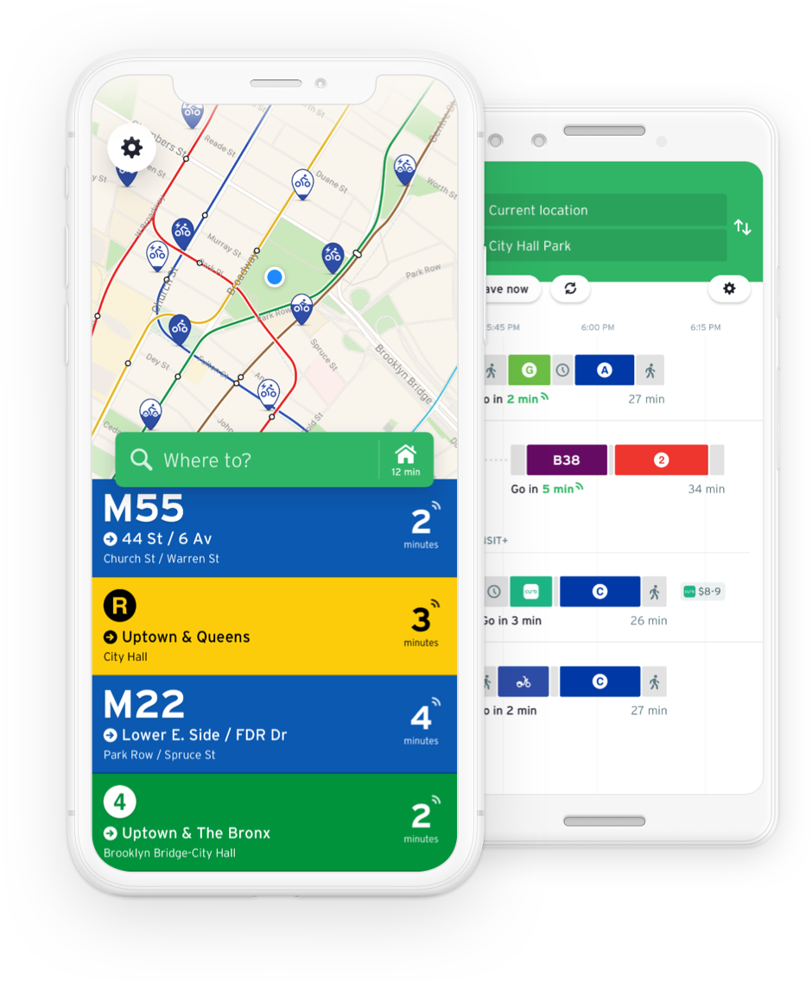



MOBILE INTERFACE DSIGN
Based on the user needs identified, we developed a design strategy that focuses on simplicity, clarity, and user control.

Slide 4







DESING TOOL
Collaborative design: Figma enables real-time collaboration and seamless teamwork among designers.
Cloud-based platform: Figma operates in the cloud, allowing easy access to design files from anywhere.
Interactive prototyping: Figma offers built-in prototyping capabilities for creating interactive and clickable prototypes.
Design system and component libraries: Figma supports the creation and management of design systems and reusable components for consistent and efficient design.

Slide 5



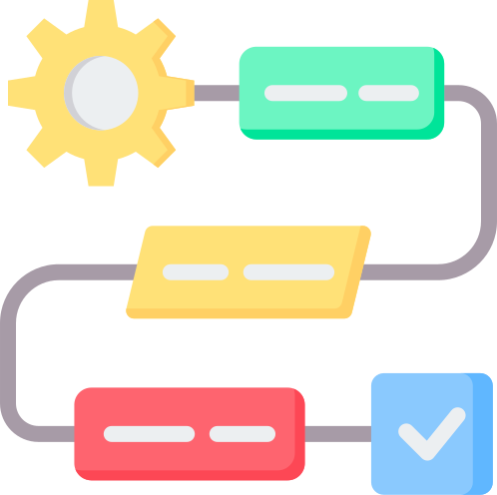
DESIGN PROCESS
1. Brainstorming
2. Prototyping
3. Iteration

Slide 6
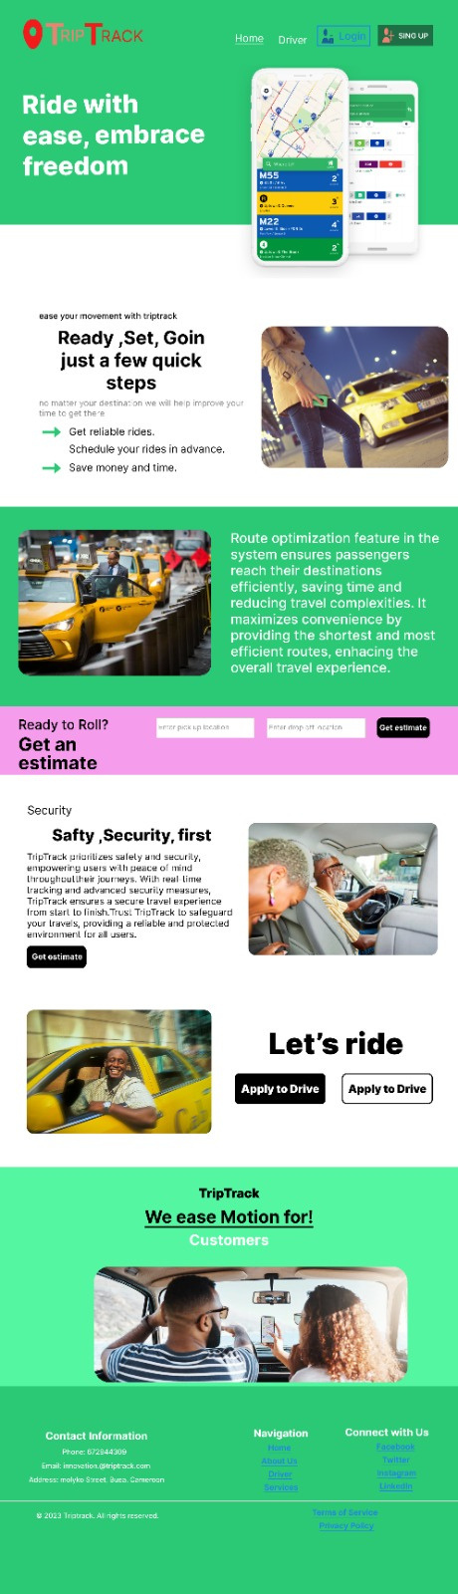
LANDING PAGE

Slide 7
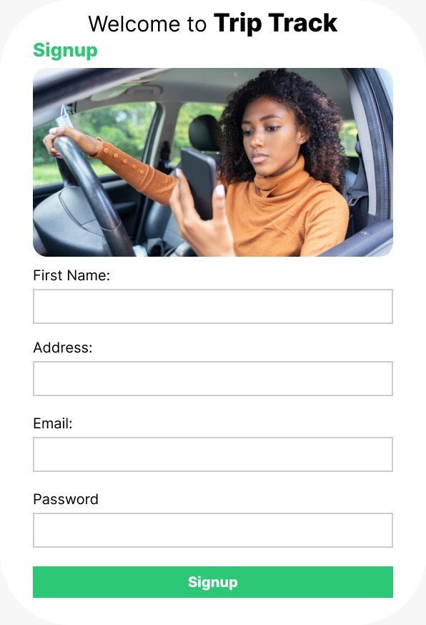
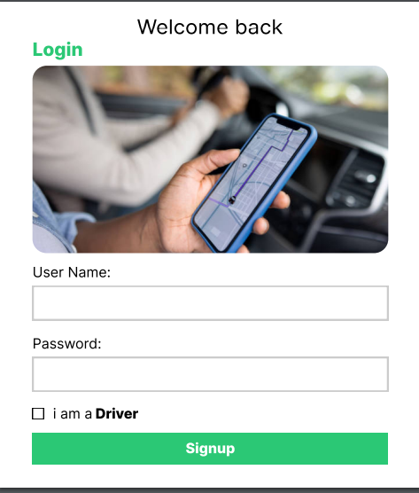
SIGNUP FORM
LOGIN FORM

Slide 8
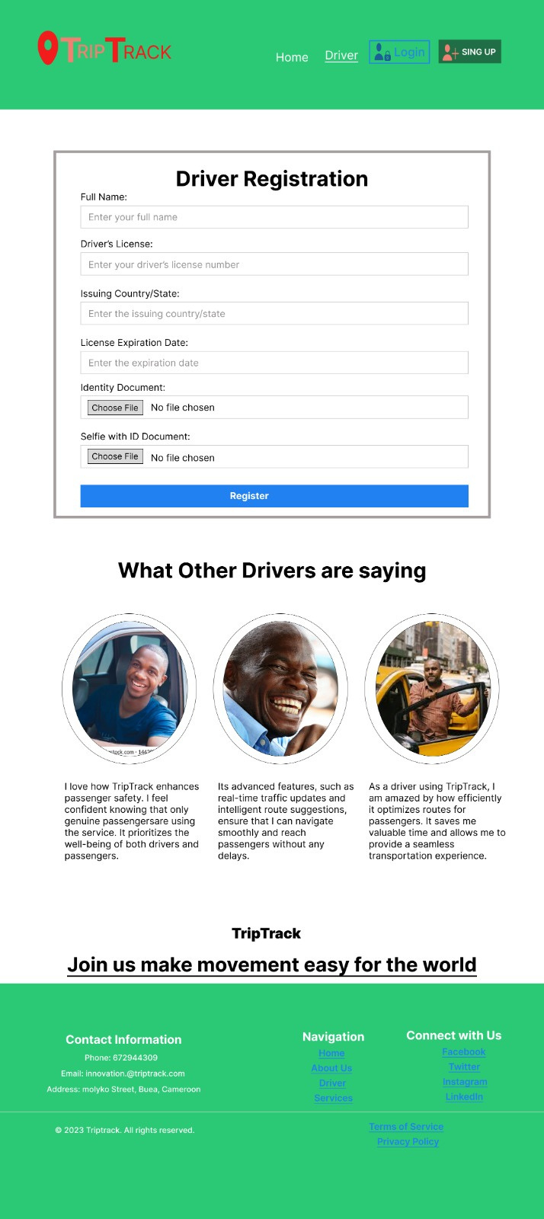
DRIVER PAGE

Slide 9
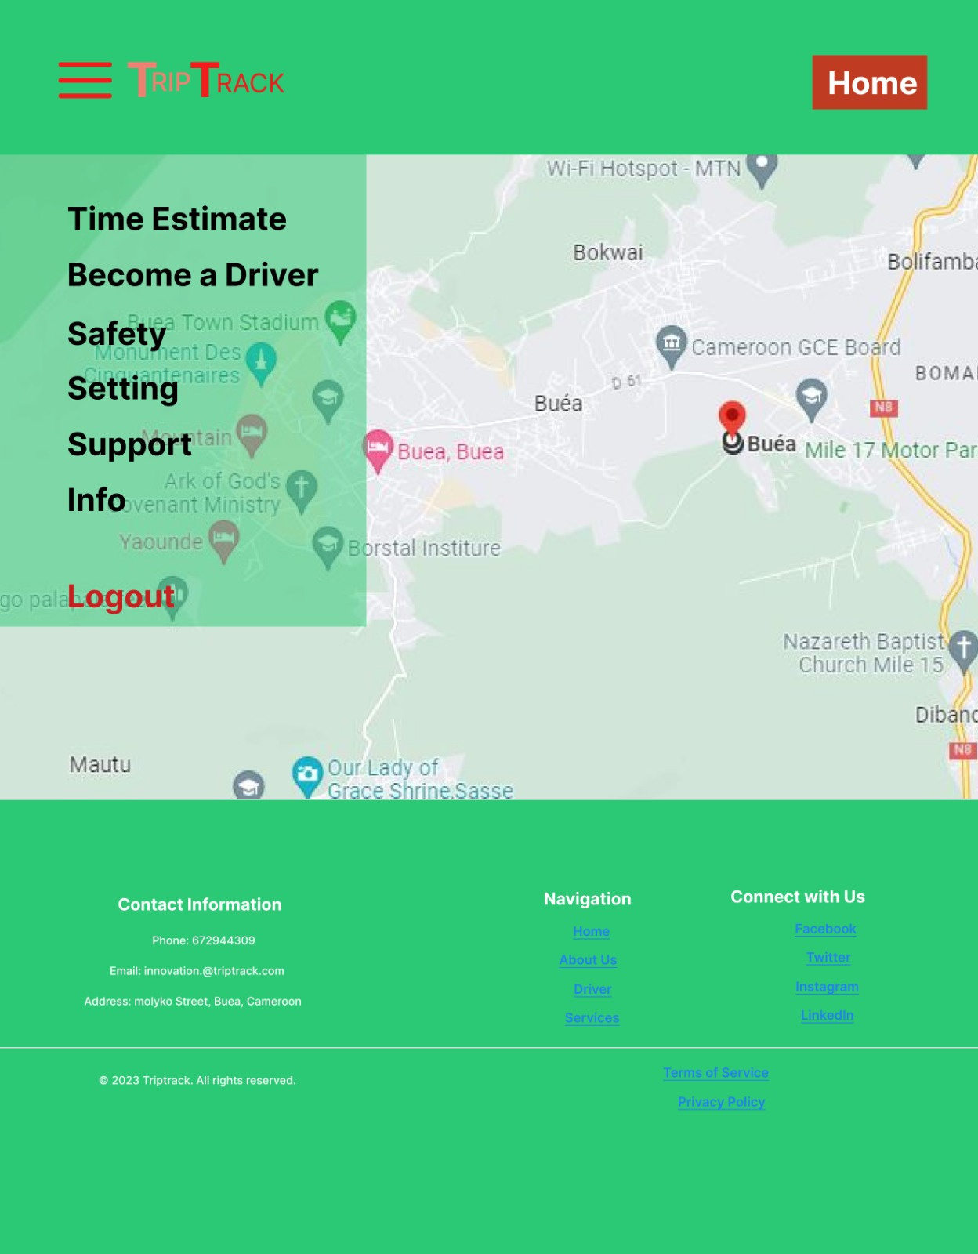

Slide 10







IMPLEMENTATION
technologies
-HTml
CSS
JS
BOOTSTRAP
DJANGO

Slide 11

TESTING
Task based texting
Navigation testing
mobile responsiveness testing
form and input testing
accessibility testing

Slide 12
THANK YOU!!

